Slide 1

COOMET
Update to the RLMO Round Table
Valery Hurevich, COOMET President
RLMO Round Table meeting - September 27, 2022

Slide 2
Overview of significant developments and activities during the past year in COOMET
NIM of Romania terminated its membership in COOMET in October 2021, limiting itself to cooperation in EURAMET; NIM of the DPR of Korea also withdrew from COOMET.
Full members - 14
Associated members - 5

Slide 3
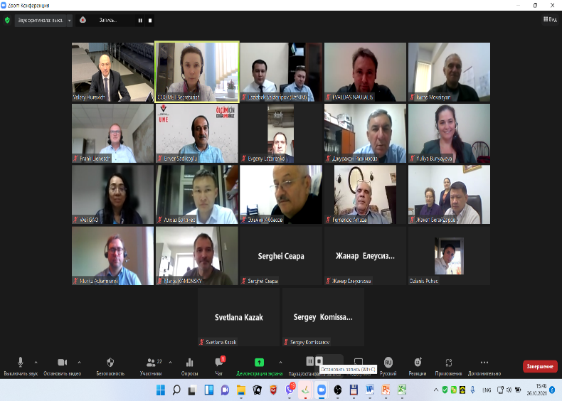
Overview of significant developments and activities during the past year in COOMET
32nd extraordinary COOMET Committee meeting (26 October 2021, online)
Main results:
Results of the Survey to define the positions of COOMET member countries on the issues of membership in COOMET, institutional status and funding of COOMET activities were discussed
Discussion was held on the issues of:
possible changes in the format of membership in COOMET (possibility of concluding an intergovernmental agreement, transition to an association of national metrology institutions etc.);
possible further actions to change the institutional status of COOMET (possibility and appropriateness of registration of a legal entity for the needs of COOMET and for the operation of the permanent Secretariat);
possible further actions on funding of COOMET activities (including options for building a fee scale for the future COOMET budget and items of the expenditure side of the budget).
Discussion on all the issues continued within the WG for COOMET Strategy (in 2021 – 2022 four meetings of the WG were held).

Slide 4
Overview of significant developments and activities during the past year in COOMET
Resolutions of the 29th COOMET Presidential Council meeting (13 June 2022, online):
The issue will be submitted to the COOMET Committee for approval (25-27.10.2022)
To recommend to the COOMET Committee to suspend the activities of the Working Group for Preparation of the COOMET Development Strategy.
To take note of the achievements of the WG for Strategy as to the change of the institutional status of COOMET and to use them in reactivating WG activities.
To endorse in general proposals of the WG for Strategy on the formation of the revenue and expenditure side of the COOMET budget and to use them as a basis for a feasibility study of the COOMET budget and to use them in reactivating WG activities.
To continue discussion on the update of tasks and fields of cooperation in legal metrology within the COOMET Presidential Council.
To request the COOMET Secretariat to organize a survey among COOMET Committee members to identify their vision for possible options to enhance cooperation without changing the organizational and legal form of COOMET (in view of the discussion held at the 13th meeting of the WG for Strategy (17.02.2022)) by 01.10.2022. To present the results at the next COOMET Committee meeting.

Slide 5
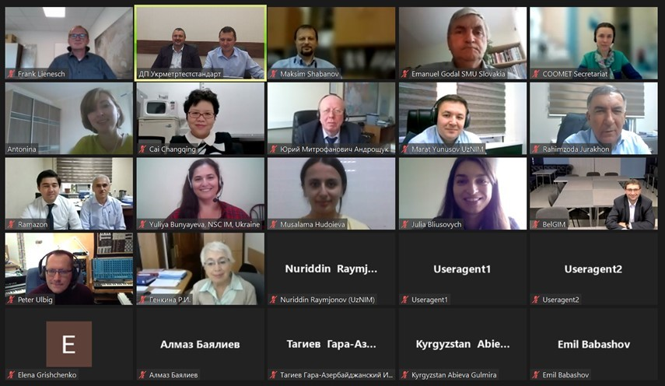


Overview of most urgent technical and other legal metrology issues in the region during the past year in COOMET
22nd TC 2 “Legal metrology” meeting was held online on 27-28 September 2021
Exclusion of subcommittees from the structure of TC2
Fields of cooperation in LM:
1.Measuring devices in the field of LM
2.Measuring systems in the field of LM
3.Medical equipment with measuring functions
4.Conformity assessment of MI
5.Digitalization in LM
6.General principles of metrological control and supervision

Slide 6
Overview of most urgent technical and other legal metrology issues in the region during the past year in COOMET
Activities of COOMET TC 2 “Legal Metrology” in 2022
Translation
Translation of the Brochure UNIDO-OIML "Certification of measuring instruments"
Translation of Document OIML D1:2020
Translation of D10, D30, D32, R75, G14
Drafting of a list
of accepted rules, guidelines, recommendations in the field of legal metrology of other RLMOs of interest to COOMET countries,
Discussion of the possibility of their application in COOMET member countries is planned.

Slide 7
Overview of most urgent technical and other legal metrology issues in the region during the past year in COOMET
Tasks of COOMET TC 2 “Legal Metrology” for 2022-2023
Translation of D11, D31, D 33, R125
Update of COOMET Recommendations
R/LM/28:2016 "Typical test program for software of measuring instruments"
R/LM/8:2002 "Construction, presentation, design and content of the Type description of the of measuring instrument for the national register of measuring instruments“
R/LM/25:2015 "Procedure for recognizing technical devices as measuring instruments"
R/LM/26: 2015 "General requirements for the competence of verification laboratories"
Implementation of the COOMET project:
716/BY-а/17 Development of rules for setting up reverification and recalibration intervals for measuring instruments used in the field of legal metrology
797/BY/19 Review of approaches to the metrological support of medical measuring instruments

Slide 8
Anticipated calendar of events for the coming year in COOMET
33nd extraordinary COOMET Committee meeting (25 to 27 October 2022, online);
23rd COOMET TC 2 “Legal metrology” meeting (December 2022, online);
34th COOMET Committee meeting & COOMET seminar on digital transformation in metrology (spring 2023);
X International competition “Best Young Metrologist of COOMET” (June 2023);
24th COOMET TC 2 “Legal metrology” meeting (autumn 2023)

Slide 9
COOMET Comments on the RLMO discussion topics for this year
Discussion Topic: How is your RLMO approaching ‘digitalization’ pertaining to measuring instruments in your region?
A COOMET Task Group on the Issues of Digital Transformation in Metrology was established.
A draft COOMET Concept for the issues of digital transformation in metrology and Roadmap for the implementation of the Concept are under discussion.
The Concept covers the following aspects:
review of electronic documents in metrology and formulation of requirements to their formats and structure;
use of FAIR+T data;
use of digital technology in COOMET activities;
use of cloud and grid technology in metrology in COOMET member countries;
development of recommendations on the structure of and requirements for the objects of digitalization which are constituent parts of the digital platforms of COOMET member countries;
development of common approaches to the creation and maintenance of national information funds in the field of ensuring the uniformity of measurements in COOMET member countries
Work has commenced under COOMET project 850/DE/21 “Development of a harmonized approach to use digital calibration certificates in COOMET member countries”.

Slide 10
COOMET Comments on the RLMO discussion topics for this year
Discussion Topic: How is your RLMO approaching ‘digitalization’ pertaining to measuring instruments in your region?
COOMET Concept: To create conditions for digital transformation in metrology a number of actions is recommended, including preparation of COOMET recommendations on the content of national or regional documents defining the structure and requirements to the objects of digitalization (digital objects), including requirements for:
at the national level:
repositories of digital documents;
digital directories (codifiers, rubricators etc.);
digital MI group card descriptions;
digital verification schemes;
Unified Codes for Units of Measure;
digital calibration and verification certificates for MIs;
digital certificates, data sheets and type descriptions for MIs and RMs;
at the regional level: information and communication e-infrastructure of NMIs of member countries to ensure information security when transferring data to the COOMET digital platform.
Work has commenced under COOMET project 850/DE/21 “Development of a harmonized approach to use digital calibration certificates in COOMET member countries”.

Slide 11
COOMET Comments on the RLMO discussion topics for this year
Discussion Topic: How is your RLMO approaching the regulation of smart meters in your region?
In August - September 2021 a survey was conducted among members of TC 2 “Legal Metrology” on this issue.
Question 1: Are there legal requirements in your country regarding the mandatory ature/appropriateness/necessity of using smart meters?
Question 2: Are there technical requirements in your country regarding smart meters?
Question 3: Are there documented procedures and methods for metrological control and supervision of smart meters in your country?
Question 4: Have smart meters already been used in your country?
Question 5: Is your country considering inclusions of smart meters in the scope of legally regulated metrology?
Question 6: Will there be legal control and supervision of smart meters in your country and in what form?

Slide 12
COOMET Comments on the RLMO discussion topics for this year
Discussion Topic: How is your RLMO approaching the regulation of smart meters in your region?
COOMET survey
The answers were received from: AZ, BY, CN, CU, KZ, MD, RU, SK, TJ, UZ.
Question 1
Are there legal requirements in your country regarding the mandatory nature/appropriateness/necessity of using smart meters?
Country | AZ | BY | CN | CU | KZ | MD | RU | SK | TJ | UZ
Yes |  |  | + | + |  | + |  | + | + | +
No | + | + |  |  | + |  | +

Slide 13
Comments on the RLMO discussion topics for this year
Discussion Topic: How is your RLMO approaching the regulation of smart meters in your region?
COOMET survey
Question 2
Are there technical requirements in your country regarding smart meters?
 | Electricity meters | Gas meters | Water meters | Heat meters
Requirements available: | CN, MD, UZ, SK | CN, MD, UZ, SK | MD, UZ, SK | MD, SK
Hardware requirements | CN | CN | CN | CN
 | TJ
 | UZ | UZ | UZ
 | SK | SK | SK | SK
Software requirements | CN | CN |  | CN
 | TJ
 | UZ | UZ | UZ
 | SK | SK | SK | SK
Metrological requirements | CN |  |  | CN
 | TJ
 | UZ | UZ | UZ
 | SK | SK | SK | SK
Electricity grid quality requirements | TJ
 | SK | SK | SK | SK
Cyber-security requirements | CN
 | TJ
 | UZ | UZ | UZ
Personal data protection requirements and data privacy requirements | CN
 | TJ
 | UZ | UZ | UZ
 | SK | SK | SK | SK

Slide 14
Comments on the RLMO discussion topics for this year
Discussion Topic: How is your RLMO approaching the regulation of smart meters in your region?
COOMET survey
Question 3
Are there documented procedures and methods for metrological control and supervision of smart meters in your country?
Electricity meters | Gas meters | Water meters | Heat meters
CN | CN | CN
CU | CU in the process of updating | CU | CU
TJ
SK | SK | SK | SK
MD | MD | MD | MD
Work has commenced under COOMET project 850/DE/21 “Development of a harmonized approach to use digital calibration certificates in COOMET member countries”.

Slide 15
COOMET Comments on the RLMO discussion topics for this year
Discussion Topic: How is your RLMO approaching the regulation of smart meters in your region?
COOMET survey
Question 4
Have smart meters already been used in your country?
 | Electricity meters | Gas meters | Water meters | Heat meters
How many types of meters are made in your country | CN Different types of meters for State Grid and for China Southern Power Grid | CN 1 type | CN 2 types | CN 3 types
 | CU |  |  | CU
 | AZ: 2 types |  | AZ: 13
 | UZ: 7 types | UZ: 6 types
How many types of meters are imported from other countries | CN Some gateway meter |  | CN 2 types | CN 3 types
 | CU: all |  |  | CU: all
 | AZ: 10 types | AZ: 11 types | AZ: 10 types
 | TJ: 11 types
 | UZ: 11 types | UZ: 3 types
Comments: | MD: In the Republic of Moldova electricity meters and water meters are produced. Manufacturer's data: https://addgrup.com/ru/. We don't have information about the number of meter types imported from other countries.
 | TJ: All types of electricity meters are electronic (static) meters, accuracy classes are 0.2, 0.2S, 0.5, 0.5S, 1 and 2 respectively. Currently preparation for the production of smart meters for our own needs, i.e. within the state, is carried out |  | TJ: Under consideration
 |  |  | UZ: not applied | UZ: not applied
 | SK: There is no accurate record. Meters must have an EU certificate. Customer selects an appropriate type

Slide 16
COOMET Comments on the RLMO discussion topics for this year
Discussion Topic: How is your RLMO approaching the regulation of smart meters in your region?
COOMET survey
Question 5
Is your country considering inclusions of smart meters in the scope of legally regulated metrology?
The answers of the countries that answered NO to question 1 are given below (AZ, BY, KZ, RU)
Country | AZ | BY | KZ | RU
Yes |  | +
No | + |  | +
 | Electricity meters | Gas meters | Water meters | Heat meters
Comments: | BY: For all meters used in commercial metering
 | AZ: All mentioned meters are within the scope of legal metrology.
 | RU: All meters, including of smart meters ones, are included in the scope of legally regulated metrology in the Russian Federation. Special allocation of smart meters to include them in the scope of legally regulated metrology in the Russian Federation is not planned.

Slide 17
COOMET Comments on the RLMO discussion topics for this year
Discussion Topic: How is your RLMO approaching the regulation of smart meters in your region?
COOMET survey
Question 6
Will there be legal control and supervision of smart meters in your country and in what form?
The answers of the countries that answered NO to question 1 are given below (AZ, BY, KZ, RU)
Country | AZ | BY | KZ | RU
Yes | + | +
No |  |  | +
 | Electricity meters | Gas meters | Water meters | Heat meters
Comments: | BY: 1) State verification in laboratories; 2) remote verification for supervision in the operation period between verifications.
 | AZ: Yes
 | RU: Legal control and supervision of smart meters, as well as other utility meters, in the Russian Federation is carried out in the forms of tests for the purpose of type approval measuring instruments and verification of measuring instruments.

Slide 18
COOMET Comments on the RLMO discussion topics for this year
Discussion Topic: How is your RLMO approaching the regulation of smart meters in your region?
CONCLUSIONS on the results of the survey:
1. The results of the survey demonstrate ambiguous understanding of the term "smart meters" in different countries (in some countries they are considered as any electronic measuring devices that allow reading the required legally controlled and fiscal data from them).
2. The results of the survey demonstrate in general interest from the countries in using smart meters, as well as a lack of uniform understanding from the regulators at the national level regarding this innovative approach to metering and resource saving potential.
In our view, there is also no understanding of benefits for consumers from working with smart meters (the legislation does not define benefits for consumer from using "smart measuring systems"; automated metering systems are widely introduced both in the industrial and domestic sectors, but it is not clear whether they meet the concept of "smart systems").
3. It is appropriate to continue discussion of the problem of using smart meters in COOMET countries within COMET TC 2.

Slide 19
COOMET Comments on the RLMO discussion topics for this year
Discussion Topic: How is your RLMO approaching the regulation of smart meters in your region?
PROPOSALS
1. A term "smart meters" should be formulated within OIML (as measuring instruments, with the indication of their metrological features in view of the "smart" technology), so that this term has the same meaning in all countries and regions.
2. In view of:
some peculiarities in terms of technical requirements for smart meters of different categories (electricity meters, heat meters, gas and water meters),
the need for global unification of requirements and approaches to metrological control,
we suggest considering a possibility of adding special clauses establishing requirements to smart meters and test methods to validate this technology to the following international OIML recommendations:
OIML R 46 Active electrical energy meters;
OIML R 49 Water meters for cold potable water and hot water;
OIML R 75 Heat meters;
OIML R 137 Gas meters.

Slide 20

Summary/Concluding remarks
COOMET TC2 “Legal metrology“ intends to:
Continue the exchange of information on international requirements and best practices in the field of legal metrology;
Continue translating OIML publications into Russian;
Provide guidance on the application of the requirements of OIML publications regarding measuring instruments and methods for their testing, as well as other objects of legal metrology in COOMET member countries;
Prepare training in the field of LM together with COOMET TC4 "Information and Training";
Promote and support the development of the OIML CS in COOMET member countries.

